Slide 1





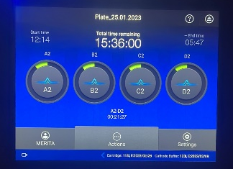
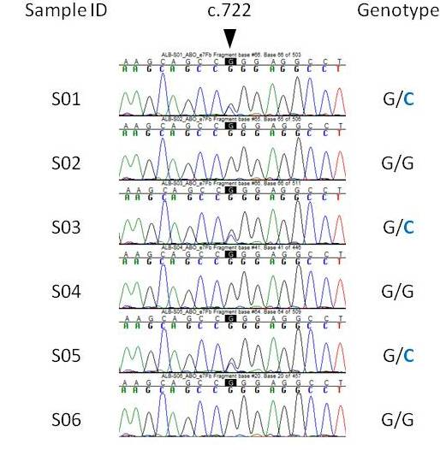
BIOMARKERS IN RARE GENETIC DISEASES - RESEARCH GROUP
Contact person/Group leader:
Prof. Asoc. Merita XHETANI
Affiliation
Department of Biology, FNS, University of Tirana and Center of Molecular Diagnostics and Genetic Research, SUOGJ, Tirana, Albania.
Mail address
Office 204, Building B, Blv. Zogu I, No. 25/1, 1001 Tirana, Albania
Email/website
merita.xhetani@fshn.edu.al; merita.Xhetani@unitir.edu.al
https://fshn.edu.al/departments/departamenti-i-biologjise/personel/prof-asoc-dr-merita-xhetani
Group Members
Prof. Asoc. Merita Xhetani, Prof. Dr. Marijana Petković, Ariol Rama, Dr. Blerta Laze, Dr. Suela Leli, PhDc. Albina Hasa, PhDc. Ela Zaimi, Phdc. Blend Jerliu,
Google Scholar
https://scholar.google.com/citations?user=bxudXTcAAAAJ&hl=en
ORCID
https://orcid.org/0000-0001-6982-5498
Research lines
Establishing and providing access to harmonized data and samples, performing the molecular and clinical characterization of rare diseases, boosting translational, preclinical and clinical research, streamlining ethical and regulatory procedures.
Establishing well-characterized and organized collections of biological samples (biobanks) for biomarker discovery, patient registries with well-defined phenotypes that are linked to the biological samples that will help to uncover the pathophysiology of still uncharacterized diseases.
Using integrated omics technologies as the driving force in personalized medicine for biomarker discovery.
Characterizing diseases at the molecular level to unravel biochemical pathways that are potential drug targets

